Slide 1
Using PowerPoint for Context Help«
Amazing what you can do
InTouchSoftware.com

Slide 2
PowerPoint everywhere
» PP everywhere
If you are like me, I use PowerPoint for virtually all my documentation
Sales Pitch
This is what PowerPoint is primarily used for
User Documents
I find Word limiting … and lacking any visual context
I strongly believe colorful diagrams are what make understand things much better than words
Technical
Diagrams, Screen shots, examples

Slide 3
» Other options for help
There are other tools that might be a better fit for your needs
Word
Sure, but best for just words
Actual Help tools
My favorite is HelpNDoc www.helpndoc.com
Easy to use
Very reasonably priced
Supports a number of different output formats
Demo tools
If you want a tool that interactively shows how to use your application, I would recommend Demo Builder www.demo-builder.com
Impressive capabilities
Numerous features
Very reasonably priced
Supports a number of different output formats

Slide 4
PowerPoint Automation
» PP automation
You may not realize is that there are a lot of useful things you can do with COM automation to make PowerPoint even more useful … beyond just a presentation.
And do it directly in Office, no additional software necessary
As contextual help
You spent time making PowerPoint full of useful information, why not allow your Windows application be able to directly reference this information?
Use any text as data which can be written to and read from
Think of it like a form letter or simple data store
Inject data from outside sources
Reference / highlight particular slides / fields

Slide 5
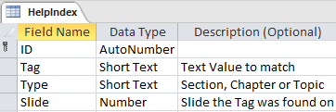
» Components
The included HelpClass code is all you need
There are three methods
Help.Connect “PowerPint file”
You need to first connect
Help.BuildIndex
Scans your PowerPoint file for tags and creates a simple index file
If your PowerPoint file is more than 10 pages or so, for performance, it is best to make use of a table to store the tag slide values.
Not needed in .Net help.class
Help.OpenSlide “Some Tag”
Pass in a slide tag value that is in your help index table and that slide will be displayed
Office VBA code
Access
Index
Table
.Net
C# Code
Power Point

Slide 6
PowerPoint «
Tagging help

Slide 7
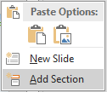
» Tagging
In this demo, there are three categories of tags that are utilized
These tags form a sort of an organizational structure to your help index
Any shape can contain a text tag as long as it is not part of a group of objects
You can use any character you want for tagging but you will need to change the code references if you do
Section
Sections are added by right-clicking between any slide and selecting “Add Section”
Chapter
For a Chapter tag in this demo, we are using the character with the text to the left
Example: PowerPoint
Topic
For a Topic tag in this demo, we are using the character with the text to the right
Example: Tagging
Note that you can use any character that you want for tagging, you just need to change the matching character in the code
Example:

Slide 8
MS Access «
Supports help index table and demo form

Slide 9
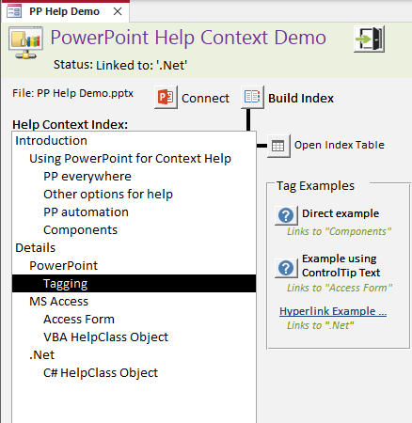
» Access Form
In this demo we are using MS Access as it is the best data centered application in the Office family
Access forms are part of Office and make binding to tables very easy
Any Office (VBA) or VB application can be utilized however, you will still need Access or some other database to provide some form of an index table

Slide 10
» VBA HelpClass Object
The core functionality is provided by the HelpClass object
Simply add the class to your application and then reference it
It has three basic functions
Connect
To connect to the PowerPoint application
BuildIndex
The HelpIndex table is updated with the tags found in the connected PowerPoint file
The index table is required for fast operation as the process of going through all shapes on every slide is a relatively slow process.
OpenSlide “SomeTag”
Opens up PowerPoint to the requested “Tagged” slide
Uses the BuildIndex table to lookup the slide Page number

Slide 11
.Net «
Using the HelpClass in .Net apps

Slide 12
» C# HelpClass Object
The C# HelpClass object provides code for .Net based applications
Note references to MS Office and Interop.PowerPoint
There are just two methods
The BuildIndex method is provided by the Access code
Connect (PowerPoint File)
OpenSlide (Tag)

